Slide 1
Control of vortex shedding behind a cylinder using a control cylinder
Ashesh Thamir (200205)
Bharoth Ramnaik (200268)
Notes:
Be specific and direct in the title. Use the subtitle to give the specific context of the speech.
-The goal should be to capture the audience’s attention which can be done with a quote, a startling statistic, or fact. It is not necessary to include this attention getter on the slide.

Slide 2
Aim:-
To investigate the control of vortex shedding behind a cylinder using a control cylinder in a 2D flow, analyzing its effects on vortex dynamics, wake structure, and aerodynamic forces to achieve flow stabilization and drag reduction.
Notes:
Use the background points to post details that are not common knowledge, or that the audience will need to understand the context of the speech.
-Do not read these main points from the PowerPoint, instead elaborate on these points during the speech.

Slide 3
Discussion points
Cylinder diameter & Flow rate.
Qualitative or quantitative approach for experiment.
Capture only images.
Whether to perform image processing.
If yes, what parameters are to be analysed.
What values are to be calculated.
Notes:
Dedicate this entire slide to the thesis statement. It is the reason the speech is being given. Use this time to reveal the three main points of the speech (slides 4,5,6) as an overview for the direction of the speech:
-[type main point #1 here]
-[type main point #2 here]
-[type main point #3 here]
Be sure to transition to the first main point and the next slide.

Slide 4
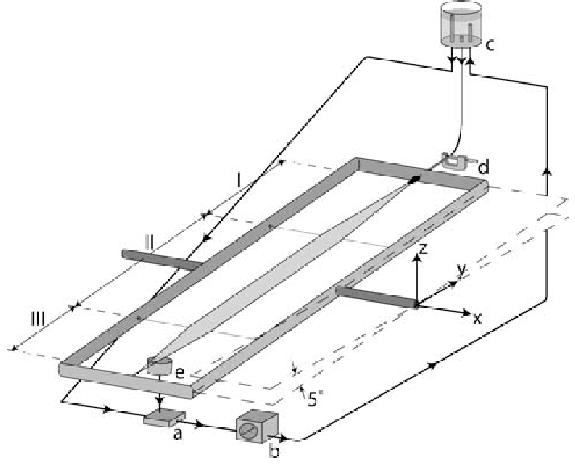
Apparatus Required
Inclined soap film tunnel
Cylinders of different diameters.
Motor with controllable rpm
High quality camera.
Notes:
The title of main point #1 should be clear and concise. Each piece of evidence should be summarized for clarity and cited correctly. Do not simply read the pieces of evidence, but elaborate where needed.
[type notes for elaboration here]
Be sure to transition to main point #2 and the next slide.

Slide 5
Procedure
Capture the vortex shedding behind static cylinder for reference.
Capture the flow separation distance for the primary cylinder with different rpm.
Place a static cylinder behind the primary cylinder (one connected with motor.
capture the vortex shedding behind secondary cylinder at different rpm of primary cylinder.
Notes:
The title of main point #2 should be clear and concise. Each piece of evidence should be summarized for clarity and cited correctly. Do not simply read the pieces of evidence, but elaborate where needed.
[type notes for elaboration here]
Be sure to transition to main point #3 and the next slide.

